Slide 1
Unit 4
Indexing, File Organization, Query Optimization

Slide 2
File Organization in DBMS
File organization in DBMS refers to the method of storing data records in a file so they can be accessed efficiently. It determines how data is arranged, stored, and retrieved from physical storage.
The Objective of File Organization
It helps in the faster selection of records i.e. it makes the process faster.
Different Operations like inserting, deleting, and updating different records are faster and easier.
It prevents us from inserting duplicate records via various operations.
It helps in storing the records or the data very efficiently at a minimal cost.

Slide 3
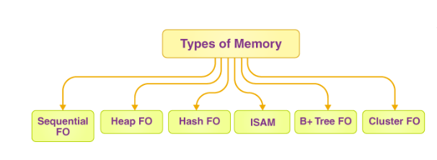
File Organization in DBMS
Types of File Organizations
Various methods have been introduced to Organize files. These particular methods have advantages and disadvantages on the basis of access or selection. Thus it is all upon the programmer to decide the best-suited file Organization method according to the requirements.
Some types of File Organizations are:
Sequential File Organization
Heap File Organization
Clustered File Organization
ISAM (Indexed Sequential Access Method)
Hash File Organization
B+ Tree File Organization

Slide 4
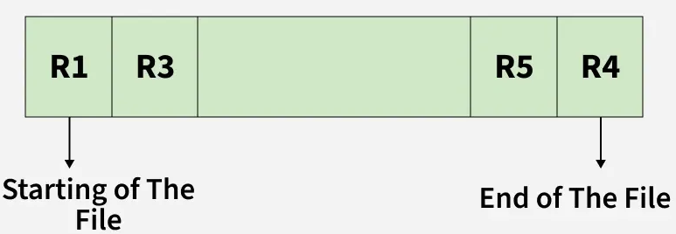
File Organization in DBMS
Sequential File Organization
The easiest method for file Organization is the Sequential method. In this method, the file is stored one after another in a sequential manner. There are two ways to implement this method:
1. Pile File Method
This method is quite simple, in which we store the records in a sequence i.e. one after the other in the order in which they are inserted into the tables.

Slide 5
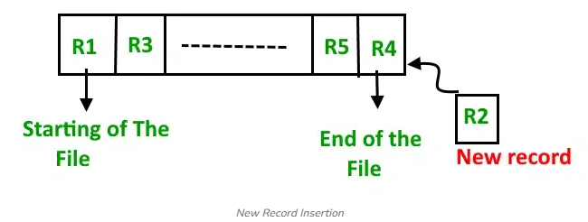
File Organization in DBMS
Insertion of the new record: Let the R1, R3, and so on up to R5 and R4 be four records in the sequence. Here, records are nothing but a row in any table. Suppose a new record R2 has to be inserted in the sequence, then it is simply placed at the end of the file.

Slide 6
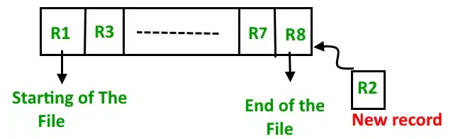
File Organization in DBMS
2. Sorted File Method
In this method, As the name itself suggests whenever a new record has to be inserted, it is always inserted in a sorted (ascending or descending) manner. The sorting of records may be based on any primary key or any other key.

Slide 7
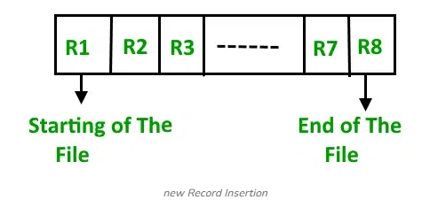
File Organization in DBMS
Insertion of the new record: Let us assume that there is a preexisting sorted sequence of four records R1, R3, and so on up to R7 and R8. Suppose a new record R2 has to be inserted in the sequence, then it will be inserted at the end of the file and then it will sort the sequence.

Slide 8
File Organization in DBMS
Characteristics
Records are stored in sorted (ordered) manner.
Good for range queries (e.g., 100 < Roll No < 200).
Efficient for sequential processing.
Insertion and deletion require reorganization of file.
How It Works
A key field is selected (mostly primary key).
Records are sorted and stored according to this key.
Searching becomes faster because DBMS can use:
Binary Search
Sequential search (in order)
Insertions and deletions are harder because the order must be maintained.
When to Use Sequential File Organization
It is best when:
Data is mostly read, not updated frequently
Records need to be processed in sort order
Range queries are common
Searching speed is important Examples:
Payroll system
Student result system
Invoice or billing system

Slide 9
File Organization in DBMS
Advantages of Sequential File Organization
Fast and efficient method for huge amounts of data.
Simple design.
Files can be easily stored in magnetic tapes i.e. cheaper storage mechanism.
Disadvantages of Sequential File Organization
Time wastage as we cannot jump on a particular record that is required, but we have to move in a sequential manner which takes our time.
The sorted file method is inefficient as it takes time and space for sorting records.

Slide 10

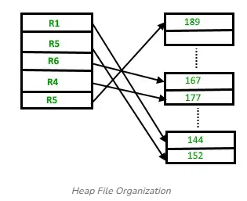
File Organization in DBMS
Heap File Organization
It is the most fundamental and basic form of file organization. It’s based on data chunks. The records are inserted at the end of the file in the heap file organization. The ordering and sorting of records are not required when the entries are added.
The new record is put in a different block when the data block is full. This new data block does not have to be the next data block in the memory; it can store new entries in any data block in the memory. An unordered file is the same as a heap file. Every record in the file has a unique id, and every page in the file is the same size. The DBMS is in charge of storing and managing the new records.

Slide 11
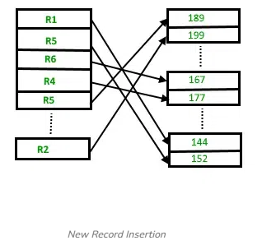
File Organization in DBMS
Heap File Organization
Insertion of the new record: Suppose we have four records in the heap R1, R5, R6, R4, and R3, and suppose a new record R2 has to be inserted in the heap then, since the last data block i.e data block 3 is full it will be inserted in any of the data blocks selected by the DBMS, let's say data block 1.
If we want to search, delete or update data in the heap file Organization we will traverse the data from the beginning of the file till we get the requested record. Thus if the database is very huge, searching, deleting, or updating the record will take a lot of time.

Slide 12
File Organization in DBMS
How It Works
The file is divided into pages/blocks.
When a new record arrives, DBMS:
Finds the first available free space in any block
Stores the record there
There is no sorting or ordering of records.
Searching requires scanning the file from beginning to end.
Characteristics
Records are stored randomly, not sorted.
Very fast insertion (just place it anywhere).
Searching is slow, especially for large files.
Good when data is inserted frequently.
Not suitable for range queries.
When to Use Heap File Organization
Use heap organization when:
Insertion is frequent
Searching is not frequent
No ordering is required
Table size is small
Temporary or log data
Examples:
Transaction logs
Backup tables
Temporary results
History tables

Slide 13
File Organization in DBMS
Heap File Organization
Advantages of Heap File Organization
Fetching and retrieving records is faster than sequential records but only in the case of small databases.
When there is a huge number of data that needs to be loaded into the database at a time, then this method of file Organization is best suited.
Disadvantages of Heap File Organization
The problem of unused memory blocks.
Inefficient for larger databases.

Slide 14
File Organization in DBMS
Clustered File Organization
Clustered File Organization stores related records from different tables together based on a common field, like a foreign key. This improves query performance for join operations by placing related data physically close on disk.
A clustered file organization keeps two or more related tables/records in a single file known as a cluster. These files consist of two or more tables within a single data block, and the mapping attributes, defining the relationships between the tables, are stored only once. These contain two or more tables in one data block and the key attributes that are related between the tables are stored only once.
This means it is cheaper to search for and retrieve distinct records from different files as they are now integrated and stored in the same cluster

Slide 15
File Organization in DBMS
Clustered File Organization
How it works
Grouping records: Records from different tables that are frequently joined are stored together in the same data block, forming a cluster.
Cluster key: The cluster is created around a common column, or "cluster key," which is often a primary key in one table and a foreign key in another.
Sorting: The data within the cluster is sorted based on the cluster key, ensuring that records with the same key value are grouped together.
Efficient access: When a query needs data from these joined tables, the database can access the relevant records directly from the cluster without having to search and combine data from separate files.

Slide 16
File Organization in DBMS
Clustered File Organization
Types of Clustered file organization
1. Indexed Clusters
The clusters are organized, such that records in an indexed cluster are stored in the order of the clustering key. However, for searching and retrieving data, an index is created on the clustering key along with physical sorting as well. When using the range queries and equality searches on the clustering key, this kind of clustering is beneficial.
2. Hash Clusters
In a hash cluster, every record is located in accordance with a hash function on the clustering key. By applying it, one can identify records with the same hash value, and therefore identify their physical location. Another great advantage of hash clustering is that by using their clustering key, it is possible to obtain an individual record very quickly. Still, since records are not sorted in a particular order, the algorithm is slower for range queries.

Slide 17
File Organization in DBMS
Clustered File Organization
Benefits
Faster queries: Significantly speeds up queries that involve joining the clustered tables, as related data is physically co-located.
Reduced search cost: Eliminates the need for the database to search and access multiple files for a single query.
Direct operations: Allows for direct insertion, update, and deletion of records through join operations.
Example
Imagine you have two tables: Departments and Employees. Employees are frequently joined with their department information. By using clustered file organization on the department_id (the cluster key), the records for employees in the 'Sales' department could be stored together in a cluster, and all records for the 'HR' department could be stored in a separate cluster. This is more efficient than storing the two tables separately and then performing a join operation every time you need to retrieve employee and department information together.

Slide 18
File Organization in DBMS
ISAM (Indexed Sequential Access Method)
ISAM (Indexed Sequential Access Method) is a file organization technique that allows records to be accessed both sequentially and randomly. It uses a pre-structured index, which is a sorted list of keys, to map directly to the location of records in a data file, enabling fast retrieval. While ISAM was originally developed for disk storage, it is used in database management systems to provide a balance of sequential and direct access for applications with relatively static data.

Slide 19
File Organization in DBMS
ISAM (Indexed Sequential Access Method)
How ISAM works
Data File: Records are stored in the data file in a sorted order based on a primary key.
Index File: A separate index file contains entries that are also sorted by the key. Each index entry is a pointer to the physical location (address) of the corresponding record or block in the data file.
Overflow Area: A separate area handles new records that are inserted and don't fit into the primary data area, also organized in a sorted manner.
Searching: To find a record, the system first searches the index to quickly locate the correct data block address, and then it retrieves the record from that location.

Slide 20
File Organization in DBMS
ISAM (Indexed Sequential Access Method)
Working Mechanism of ISAM
Searching: When searching for a record, the system first looks in the index to find the disk block that contains the record. Then, that specific block is fetched to retrieve the record. This usually takes two disk I/O operations.
Insertion: If a new record needs to be inserted, it is placed in its correct sorted position. If the block is full, the record is placed in the overflow area.
Deletion: Deleting a record involves marking it as deleted. The space is then reclaimed during a subsequent reorganization of the data file.
Updating: Updating a record involves either modifying it if the key is not changed, or deleting and re-inserting it if the key is modified.

Slide 21
File Organization in DBMS
ISAM (Indexed Sequential Access Method)
Advantages of ISAM
Fast retrieval: ISAM provides fast random access by using the index to directly locate records, which is much quicker than reading through an entire file.
Supports range and partial searches: The sorted nature of the index allows for efficient searching of ranges of data or records that start with a specific string (partial search).
Disadvantages of ISAM
Static structure: The static nature of the index means that the structure of the index tree remains fixed after creation.
Performance degradation: Frequent insertions, deletions, and updates can create "overflow chains," which are scattered records that need to be searched sequentially and can significantly slow down performance.
Inefficient for dynamic data: Because of the overflow chain issue, ISAM is not ideal for databases that undergo constant and rapid changes.

Slide 22
File Organization in DBMS
ISAM (Indexed Sequential Access Method)
Example:
An ISAM example is a simplified library database with a data file of books sorted by ISBN and a separate index file. The index file contains each ISBN and a pointer to the block address in the data file where the book's information is stored. To find a specific book, the system first uses the index to find the correct block address in the data file, then retrieves the data from that location.

Slide 23
File Organization in DBMS
ISAM (Indexed Sequential Access Method)
Example:
Data File: Contains book records, sorted by ISBN
| 123 | Book A |
| 234 | Book B |
| 345 | Book C |
| 456 | Book D |
Index File: Maps ISBNs to block addresses in the data file.
| ISBN | Block Address |
| 123 | 1 |
| 234 | 2 |
| 345 | 3 |
| 456 | 4 |

Slide 24
File Organization in DBMS
Hash File Organization
Hash File Organization is a method of storing and managing records in a database by using a hash function to determine the direct memory address or disk block location of each record. This allows for very fast access, insertion, and deletion of individual records, making it a highly efficient technique for applications requiring quick lookups.

Slide 25
File Organization in DBMS
Hash File Organization
Hash Function: A mathematical algorithm that takes a record's key value (e.g., an employee ID) as input and converts it into a specific memory address or a relative bucket number.
Hash Key/Column: The attribute of the record (often the primary key) to which the hash function is applied.
Data Buckets: The memory locations (typically one or more contiguous disk blocks) where the records are physically stored. The hash function maps keys to these buckets.
Collision: A situation where the hash function generates the same address for two different keys. Handling collisions is a critical part of hash file organization

Slide 26
Advantages
✔ Very fast equality search (exact match queries) ✔ Direct access to record ✔ Efficient for large number of inserts ✔ Works best for primary key lookups
Disadvantages
✘ Not suitable for range queries (e.g., find marks between 70–90) ✘ Bucket overflow handling needed ✘ Hash function must be chosen carefully ✘ Rehashing is costly
Where is Hash File Organization Used?
✔ Bank account search (Account No → record) ✔ Employee ID lookup ✔ Student Roll No lookup ✔ Aadhaar number lookup ✔ URL shortener systems ✔ Hash indexes (like in PostgreSQL, Oracle)

Slide 27
File Organization in DBMS
Types of Hashing
Hashing in file organization is generally categorized into two main types:
Static Hashing
In static hashing, the number of data buckets in memory remains constant, and the hash function always produces the same address for a given key.
Collision Resolution Methods: When a collision occurs in static hashing, various techniques are used:
Open Addressing (Closed Hashing): Probing for the next available empty slot in the hash table, using methods like linear probing, quadratic probing, or double hashing.
Separate Chaining (Open Hashing): Each bucket holds a pointer to a linked list that stores all records which hash to that same address
Dynamic Hashing
Dynamic hashing, also known as extendible hashing, allows the data buckets to expand or shrink dynamically as the number of records in the database increases or decreases. This approach is better suited for databases with frequent changes in size and helps maintain good performance without requiring a full rehashing of the entire file

Slide 28
Static vs Dynamic Hashing – Real-Life Summary Table
Feature | Static Hashing (Real Life) | Dynamic Hashing (Real Life)
Bucket size | Fixed hostel blocks | Hostel adds new blocks as students increase
Growth | Overflow adjustments only | Structure grows automatically
Flexibility | Low | High
Handling overload | Add temporary beds | Build a new room/floor
Similar to | Fixed parking space | Parking area expands on demand
Hash behavior | Same distribution always | Hash structure changes (splits)
Static Hashing → “Fixed drawers in your cupboard”
If full, clothes spill over or are stuffed in awkwardly
Structure doesn’t grow
Dynamic Hashing → “Cupboard with attachable new drawers”
If one drawer fills, you add a new drawer
System adjusts itself

Slide 29
File Organization in DBMS
Hash File Organization
How it works
A hash function is applied to a record's key (e.g., an ID number) to generate a number.
This number directly points to the disk block where the record is stored.
When a record is inserted, the hash function determines its block location, and the record is placed there directly.
To retrieve, update, or delete a record, the same hash function is used to find its address, allowing for direct access to the record without searching.

Slide 30
File Organization in DBMS
Hash File Organization
Advantages
Speed: Provides very fast data retrieval because records are accessed directly without a linear search.
Efficiency: Ideal for large databases that require rapid access, such as online banking or e-commerce systems.
Concurrency: Can handle multiple transactions simultaneously, as records are independent and can be accessed at the same time.
Disadvantages
Collisions: Two different keys can sometimes produce the same hash address, leading to a "collision." This requires a secondary method to resolve, such as checking the next available slot, which can slow down operations.
Static hashing: If the database grows or shrinks, a static hash file can become inefficient. It may lead to too many overflows or wasted space if the initial allocation was incorrect. .

Slide 31
File Organization in DBMS
B+ File Organization
The advanced way of an indexed sequential access mechanism is the B+ tree file organization. In File, records are stored in a tree-like structure.
The B+ tree file organization is a very advanced method of an indexed sequential access mechanism. In File, records are stored in a tree-like structure. It employs a similar key-index idea, in which the primary key is utilised to sort the records. The index value is generated for each primary key and mapped to the record.
Unlike a binary search tree (BST), the B+ tree can contain more than two children. All records are stored solely at the leaf node in this method. The leaf nodes are pointed to by intermediate nodes. There are no records in them.

Slide 32
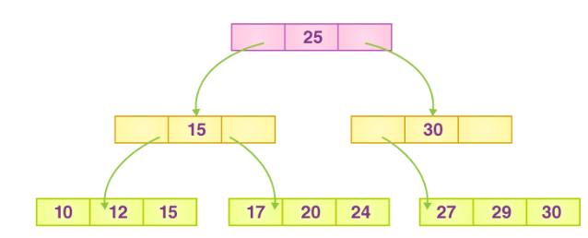
File Organization in DBMS
The tree has only one root node, which is number 25.
There is a node-based intermediary layer. They don’t keep the original record. The only thing they have are pointers to the leaf node.
The prior value of the root Is stored in the nodes to the left of the root node, while the next value is stored in the nodes to the right, i.e. 15 and 30.
Only one leaf node contains only values, namely 10, 12, 17, 20, 24, 27, and 29.
Because all of the leaf nodes are balanced, finding any record is much easier.
This method allows you to search any record by following a single path and accessing it quickly.
B+ File Organization

Slide 33
File Organization in DBMS
B+ File Organization
Advantages:
Because all records are stored solely in the leaf nodes and ordered in a sequential linked list, searching becomes very simple using this method.
It’s easier and faster to navigate the tree structure.
The size of the B+ tree is unrestricted; therefore, the number of records and the structure of the B+ tree can both expand and shrink.
It is a very balanced tree structure. Here, each insert, update, or deletion has no effect on the tree’s performance.
Disadvantages:
The B+ tree file organization method is very inefficient for the static method.

Slide 34
File Organization in DBMS
DBMS looks at the type of operations you (or the application) perform:
Requirement | Best File Organization
Search by primary key | Indexed or Clustered
Range search (BETWEEN, >, < ) | B+ Tree (Clustered index)
Insert-heavy table | Heap or Sequential
Very fast equality search | Hash
Mostly read-only table | Sequential

Slide 35
✔ Heap Example
Teacher inserts attendance log entries daily: Order does not matter → heap structure fits.
✔ Sequential Example
Bank maintains a file of customers sorted by account number.
✔ Clustered Example
Hospital file clustered by "Department": Cardiology patients stored together physically.
✔ Hash Example
Retrieve patient record by Aadhaar number (exact match).
✔ Indexed Example
Library book search by Title/Author using indexes.

Slide 36
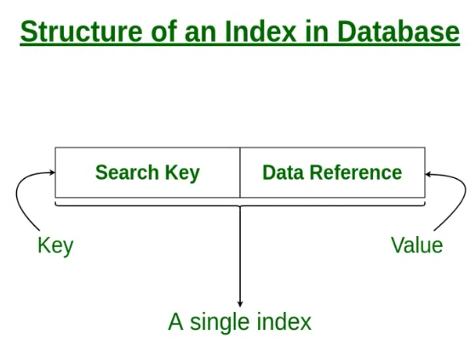
Indexing in Databases
Indexing in Databases
Indexing in DBMS is used to speed up data retrieval by minimizing disk scans. Instead of searching through all rows, the DBMS uses index structures to quickly locate data using key values.
When an index is created, it stores sorted key values and pointers to actual data rows. This reduces the number of disk accesses, improving performance especially on large datasets.

Slide 37
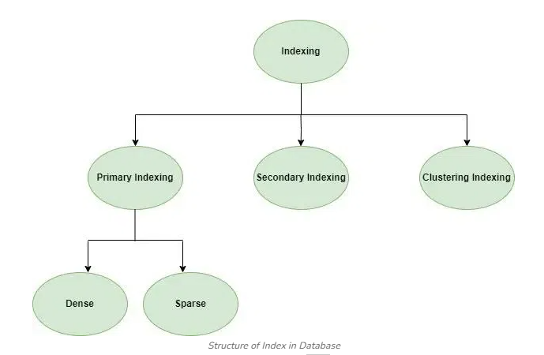
Indexing in Databases
Structure of Index in Database

Slide 38
Indexing in Databases
Types of Indexing Methods
1. Primary Indexing
This is a type of Clustered Indexing where in the data is sorted according to the search key and the primary key of the database table is used to create the index. It is a default format of indexing where it induces sequential file organization. As primary keys are unique and are stored in a sorted manner, the performance of the searching operation is quite efficient.
Key Features: The data is stored in sequential order, making searches faster and more efficient.
Indexing

Slide 39
Indexing in Databases
Types of Indexing Methods
There are different types of indexing techniques, each optimized for specific use cases.
2. Clustered Indexing
Clustered Indexing stores related records together in the same file, reducing search time and improving performance, especially for join operations. Data is stored in sorted order based on a key (often a non-primary key) to group similar records, like students by semester. If the indexed column isn't unique, multiple columns can be combined to form a unique key. This makes data retrieval faster by keeping related records close and allowing quicker access through the index.

Slide 40
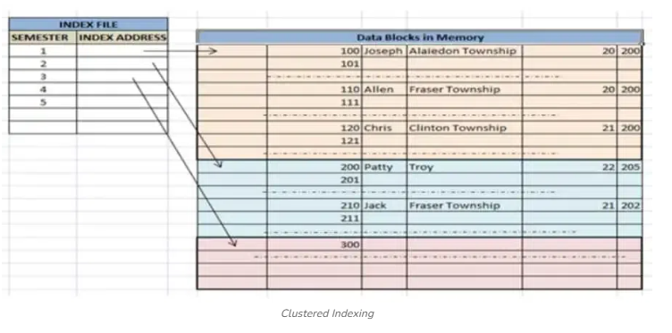
Indexing in Databases
Types of Indexing Methods
Clustered Indexing

Slide 41
Indexing in Databases
Types of Indexing Methods
3. Non-clustered or Secondary Indexing
A non-clustered index just tells us where the data lies, i.e. it gives us a list of virtual pointers or references to the location where the data is actually stored. Data is not physically stored in the order of the index. Instead, data is present in leaf nodes.
Example: The contents page of a book. Each entry gives us the page number or location of the information stored. The actual data here(information on each page of the book) is not organized but we have an ordered reference(contents page) to where the data points actually lie. We can have only dense ordering in the non-clustered index as sparse ordering is not possible because data is not physically organized accordingly.
It requires more time as compared to the clustered index because some amount of extra work is done in order to extract the data by further following the pointer. In the case of a clustered index, data is directly present in front of the index.

Slide 42
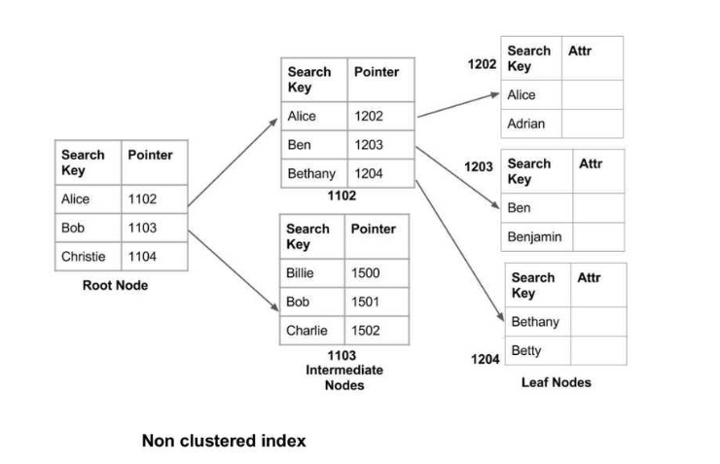
Indexing in Databases
Types of Indexing Methods
3. Non-clustered or Secondary Indexing

Slide 43
Indexing in Databases
Advantages of Indexing
Faster Queries: Indexes allow quick search of rows matching specific values, speeding up data retrieval.
Efficient Access: Reduces disk I/O by keeping frequently accessed data in memory.
Improved Sorting: Speeds up sorting by indexing the relevant columns.
Consistent Performance: Maintains query speed even as data grows.
Data Integrity: Ensures uniqueness in columns indexed as unique, preventing duplicate entries.

Slide 44
Indexing in Databases
Disadvantages of Indexing
While indexing offers many advantages, it also comes with certain trade-offs:
Increased Storage Space: Indexes require additional storage. Depending on the size of the data, this can significantly increase the overall storage requirements.
Increased Maintenance Overhead: Indexes must be updated whenever data is inserted, deleted, or modified, which can slow down these operations.
Slower Insert/Update Operations: Since indexes must be maintained and updated, inserting or updating data takes longer than in a non-indexed database.
Complexity in Choosing the Right Index: Determining the appropriate indexing strategy for a particular dataset can be challenging and requires an understanding of query patterns and access behaviours.
.

Slide 45
Cost Estimation Basics in DBMS
Cost estimation means calculating how expensive a query is for the database to execute. Database systems try to choose the fastest and cheapest way to run a query.
The cost usually depends on:
1 Disk I/O (Most Important)
Reading data from a disk is slow.
Most cost formulas are based on:
Number of blocks read
Number of blocks written
Disk I/O dominates total cost because it is MUCH slower than CPU operations.
Example: If a table has 1000 blocks, and a query performs a full table scan, → Cost = 1000 block reads
2 CPU Cost
Execution of operations like:
Comparison
Join condition checking
Sorting
Usually small compared to disk cost.
DBMS sometimes ignores CPU cost and considers only disk cost for approximation.
3 Network Cost (in distributed systems)
Data transfer between nodes.
Not relevant for single-machine DBMS.

Slide 46

What the DBMS Needs Before Estimating Cost
To calculate cost, DBMS uses:
4 Cardinality
Number of tuples (rows) in a table.
Example: Table STUDENT has 10,000 rows → cardinality = 10,000
6 Size of a tuple and size of a block
Determines how many tuples fit into a block.
Used for disk I/O calculations.
Example: Block size = 1 KB Tuple size = 100 bytes → Each block contains 10 tuples
5️ Selectivity
Fraction of rows that satisfy the condition.
Example: Query: SELECT * FROM STUDENT WHERE gender = 'F'; If 40% are female → selectivity = 0.4
Selectivity formula:

Slide 47
Cost Estimation Examples
A. Cost of Full Table Scan
If table has B blocks, full scan cost = B block reads
Example: 500-block table → cost = 500 I/Os
B. Cost of Using an Index
Index reduces search cost.
Example: Index height = 3 (Index Height in DBMS refers to the number of levels in an index structure (usually a B-Tree or B+ Tree) from the root node to the leaf node. Lower height = faster lookup, Higher height = slower lookup, Each level adds one disk access.) → Cost = 3 I/Os to reach leaf node
few more to fetch data blocks.
C. Cost of Join Operations
Each join type has a different cost:
1. Nested Loop Join
Cost = M + (M × N) (M, N are number of blocks of two tables)
2. Sort-Merge Join (Sort–Merge Join is a join algorithm used when two relations (tables) must be combined using a join condition)
Cost = Sorting cost + merging cost
3. Hash Join
Cost = building hash + probing hash

Slide 48
Why Cost Estimation is Needed?
DBMS uses cost estimation to choose the best execution plan for a query.
Example:
SELECT * FROM EMP WHERE age = 25;
Two possible methods:
Full table scan → 5000 I/Os
Index scan → 5 I/Os
DBMS picks method 2 because its cost is lowest.

Slide 49
Query Optimization Techniques (DBMS)
Query Optimization is the process of selecting the most efficient way to execute a SQL query. The DBMS optimizer evaluates many possible query execution strategies and picks the one with minimum cost (I/O, CPU, time).
There are two main types of optimization techniques:
1. Heuristic (Rule-Based) Optimization
Heuristic = “Rule of thumb.” These are general rules used to rearrange or simplify the query before executing.
⭐ Common Heuristic Rules:
1 Push Selection Down
Apply selection (WHERE conditions) as early as possible.
Example: Instead of scanning whole table then filtering, filter first.
SELECT * FROM EMP WHERE dept = 'CSE';
Filter dept='CSE' early → reduces number of rows → reduces cost.

Slide 50
2 Push Projection Down
Select only required columns early.
Example: If query needs only name, don’t keep all columns until last.
👉 Reduces tuple size → fewer disk blocks needed.
3️ Use Join Ordering
Join smaller tables first (if possible).
(A JOIN B JOIN C)
Better to join two small tables before joining a big one.
4 Replace Cartesian Product + Filter with JOIN
Instead of:
FROM A, B WHERE A.id = B.id
Use:
A JOIN B ON A.id = B.id
Faster and less memory usage.
5 Use Indexes
If a column is indexed, optimizer prefers index scan instead of full table scan.

Slide 51
6 Remove Unnecessary DISTINCT, ORDER BY
If not required, avoid them—they are expensive operations.
2. Cost-Based Optimization
This is the main technique used by modern DBMS (MySQL, PostgreSQL, Oracle).
The optimizer:
1 Generates multiple possible execution plans 2 Estimates the cost of each plan using:
of disk I/Os
CPU time
Selectivity
Cardinality
Index costs
Join method cost
3 Chooses the plan with lowest estimated cost

Slide 52
Components Used in Cost-Based Optimization
1 Selectivity
Fraction of rows matching condition.
2 Cardinality
Number of rows in each relation.
3 Join Algorithms
Optimizer chooses:
Nested Loop Join
Hash Join
Sort-Merge Join
4 Access Paths
Choose between:
Table scan
Index scan
Index-only scan

Slide 53
3. Transformation-Based Optimization
Query is converted into equivalent forms using relational algebra rules:
Selection pushdown
Join commutativity
Join associativity ((R⋈S)⋈T=R⋈(S⋈T) -- re-associate (regroup) the join operations.)
Projection pushdown
Purpose → reduce size of intermediate results.
Notes:
Join Commutativity is a transformation rule used in query optimization that allows the optimizer to reorder join operations without changing the final result of the query.
A join operation is commutative if:
R⋈S=S⋈R
This means the order of relations in a join can be swapped, and the output will still be the same (same tuples, though the physical order may differ).
Since join commutativity allows R join S to be rewritten as S join R, the optimizer can:
✔ Choose the smaller table as the outer table ✔ Pick a more efficient join method ✔ Reduce intermediate result sizes ✔ Generate multiple valid join trees for cost comparison

Slide 54
4. Physical Optimization Techniques
DBMS also selects physical operations:
1 Join Methods
Nested loop join
Block nested loop join
Hash join
Merge join
2 Sorting Methods
External merge sort
In-memory sort
3 Index Choices
B-tree index
Bitmap index
Hash index

Slide 55
Simple Example of Optimization
SELECT name
FROM EMP
WHERE age = 25 AND salary > 50000;
DBMS will optimize like:
Push selections down
Use index on age or salary if available
Fetch only name (projection pushdown)
Choose best join or scan method
Result → Fastest execution plan

Slide 56
What is a Query Execution Plan?
A Query Execution Plan (QEP) is a step-by-step blueprint that shows how the database will execute a SQL query.
It is generated by the Query Optimizer and shows:
Which operations will be used
In what order
Which indexes or join methods will be chosen
Estimated cost of each step
Think of it as the roadmap for executing a query efficiently.
Why is a Query Execution Plan needed?
Because a single SQL query can be executed in many ways.
Example:
Use index or scan the whole table?
Join using nested loop, hash join, or sort-merge join?
Which table to join first?
How to push selections/projections?
The plan helps the DBMS choose the fastest and lowest-cost method.

Slide 57
How is a Query Execution Plan created?
Parsing The SQL query is checked for syntax errors.
Logical Plan Generation Query is converted into relational algebra (e.g., σ, π, ⋈).
Query Optimization Many possible plans are generated using:
join commutativity
join associativity
selection pushdown
projection pushdown
Cost Estimation Each possible plan gets an estimated cost based on:
number of disk I/Os
CPU usage
size of intermediate results
available indexes
Best Plan Selected The plan with the lowest estimated cost becomes the Execution Plan.

Slide 58
What does an Execution Plan contain?
A QEP includes:
Component | Meaning
Access Path | How the table is accessed (index scan or full scan)
Join Order | Which table is joined first
Join Method | Nested loop, hash join, sort-merge join
Predicate pushdown | Applying filters early
Projection pushdown | Selecting only required columns early
Estimated cost | Approx disk + CPU cost
Estimated cardinality | Number of rows expected

Slide 59
Example of a Query Execution Plan
SELECT E.name, D.departmentName
FROM Employee E
JOIN Department D ON E.deptId = D.id
WHERE salary > 50000;
A possible plan:
Index Scan on Employee(salary) – apply salary filter
Hash Join Employee with Department
Projection – pick only required columns

Slide 60
Types of Query Execution Plans
1. Logical Query Plan
It represents the query using relational algebra operations like selection, projection, and join. It focuses on what operations will be performed, not how they will be executed.
2. Physical Query Plan
This plan specifies the actual algorithms and access methods (index scan, hash join, sort) used to execute the query. It shows how the DBMS will perform each operation physically.
3. Estimated Execution Plan
Generated before running the query, it provides estimated cost, cardinality, and chosen operations. It helps predict query performance without executing it.
4. Actual Execution Plan
Produced after running the query, showing the real cost, row counts, and actual operations used. It is used for performance debugging and tuning.

Slide 61
How to view QEP in real DBMS?
Oracle | EXPLAIN PLAN FOR SELECT * FROM table_name; SELECT * FROM TABLE(DBMS_XPLAN.DISPLAY);

